Slide 1
Detecting Deceptive Hotel Reviews using: - Natural Language Processing - Topic Modeling - Machine Classification
SpringBoard – Capstone 2
11/2/2017 (Updated 2/9/2018)
Chris Gian
github.com/chrisgian

Slide 2
Roadmap
Motivation
Data / Data Prep / Variable Engineering
Classification and Tuning
Results
Future steps

Slide 3

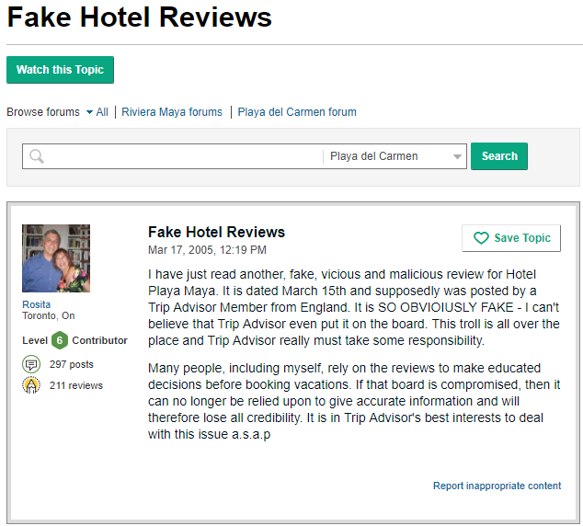
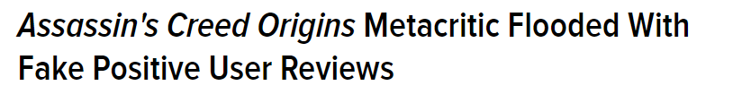

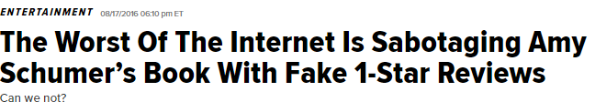


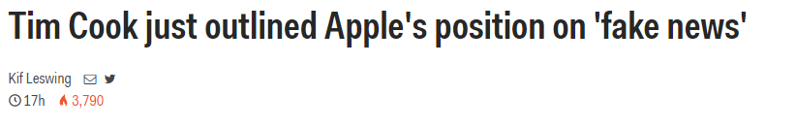
Deceptive Content Erodes Trust

Slide 4
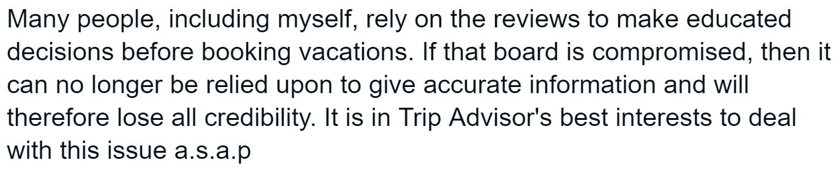
Deceptive Content Erodes Trust

Slide 5
Can you tell the difference?
 | Paid Reviewer | Real Reviewer
+ | the experince at the hard rock hotel in chicago was fantastic,i will rate them a 6 out of 5. they have wonderful service and great staff and the view is just wonderful. | I stay at this hotel 2 times a year on business and LOVE it! The staff are great, the rooms are spacious and clean, and the location is perfect for shopping and dining on Michigan Ave.
- | The Swissotel Chicago is a very mediocre hotel, the service is always poor, and the room service food always comes cold, unless it's supposed to be cold than it comes warm. I would rather stay at a super 8 than this place again. | Uhhhhh, how do I know which direction to go in??? Stains on the carpet in the room. A big gauge in the wall, where maybe a thermostat once was??? The shower is decent. All in all, for the price they charge, NO THANKS!!! I'm just glad my company is footing the bill.
Examples shortened for space.

Slide 6


Hypothetical Client
Client:
A Hotel Booking site needs to know whether it can detect deceptive reviews within a reasonable level of accuracy and wants to know what to look for in a fake review. This would be the basis of a “first line of defense” against deceptive content.
Goal:
Build a model to detect deceptive reviews
Identify the most important characteristics when detecting deceptive reviews
Solution:
Utilize techniques from natural language processing and machine learning to classify whether a hotel review is deceptive or truthful.
How was your experience at hotel X?
My experience was the best. This is the best hotel. I would only spend my money here!
Submit
Warning! Spam!
Quarantine or block?

Slide 7
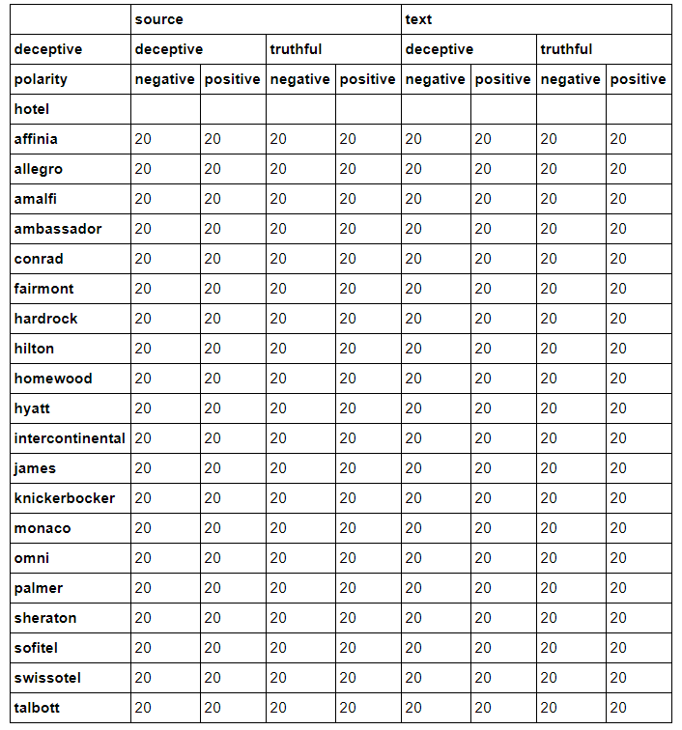
Dataset
1,600 records
50%: Deceptive
Deceptive content generated by paid reviewers through Amazon’s Mturk, a market place for work requiring human intelligence.
Truthful reviews from TripAdvisor
Data spans 20 Hotels in the Chicago Area

Slide 8
Data Prep
Create 3 Types of Variables:
Parts of Speech:
Extract components of speech from each sentence. Prep for later steps.
Polarity and Hotel variables:
Information that came with each review
Weight Meaningful Words and Group words into “Topics”
Reduce all possible words using Principle Component Analysis

Slide 9
Parts of Speech Variables
Approach and Example:
Original Sentence | "Tokenized" sentence | Remove “Stopwords” (words with little meaning) | Lemmatize (Standardize Tense) | Tag "Parts of Speech"
We stayed for a one night getaway with the family… | [We, stayed, for, a, one, night, getaway, with, the, family, …] | [We, stayed, one, night, getaway, family, …] | [We, stay, one, night, getaway, family, …] | [PRON, VERB, ADP, NUM, NOUN, NOUN, NOUN, … ]
Result
Variables | Description
1 | Noun Count
2 | Punctuation Count
3 | Verb Count
4 | Pronoun Count
5 | Adjective Count

Slide 10
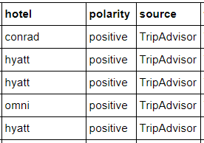
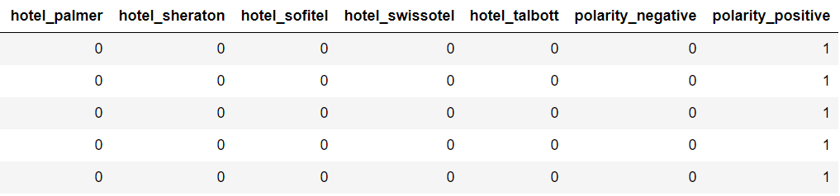
Categorical Data
Categorical Data → Dummy Variables (22 Variables)

Slide 11
Transforming our Words to Topics
Step 1. Prepped Data
 | I | We | Family | Hotel | Chicago | … | Mth Word
Review 1 | 0 | 1 | 0 | 1 | 1 | … | 1
Review 2 | 0 | 0 | 1 | 1 | 1 | … | 1
Review 3 | 1 | 0 | 1 | 1 | 1 | … | 1
Review 4 | 1 | 1 | 1 | 0 | 0 | … | 0
Review 5 | 1 | 0 | 0 | 1 | 0 | … | 1
… | … | … | … | … | … | … | 1
Review N | 1 | 1 | 1 | 1 | 0 | 1 | 0
Step 2. Weight according to how often a word appears within and across reviews
Step 3. Group words into “Topics”
 | I | We | Family | Hotel | Chicago | … | Mth Word
Review 1 | 0 | 0.061086 | 0 | 0.844036 | 0.12947 | … | 0.390538
Review 2 | 0 | 0 | 0.563086 | 0.329746 | 0.837083 | … | 0.674166
Review 3 | 0.048645 | 0 | 0.223883 | 0.001823 | 0.070719 | … | 0.782855
Review 4 | 0.71509 | 0.25766 | 0.99956 | 0 | 0 | … | 0
Review 5 | 0.269133 | 0 | 0 | 0.955859 | 0 | … | 0.635496
… | … | … | … | … | … | … | 0.125536
Review N | 0.981846 | 0.49423 | 0.52418 | 0.76736 | 0 | 0.642885 | 0
 | Topic 1 | Topic 2 | Topic 3 | Topic 4 | Topic 5 | … | Topic N
Review 1 | 0.128233 | 0.580455 | 0.834772 | 0.350905 | 0.683768 | … | 0.939091
Review 2 | 0.216463 | 0.477634 | 0.435082 | 0.484868 | 0.069642 | … | 0.322344
Review 3 | 0.862888 | 0.363755 | 0.583587 | 0.568093 | 0.071966 | … | 0.32307
Review 4 | 0.488867 | 0.001899 | 0.073112 | 0.943699 | 0.365091 | … | 0.911353
Review 5 | 0.321125 | 0.893072 | 0.748353 | 0.665679 | 0.235915 | … | 0.753524
… | … | … | … | … | … | … | 0.000744
Review N | 0.793765 | 0.46612 | 0.820786 | 0.795149 | 0.225554 | 0.932633 | 0.059631

Slide 12
Creating a Baseline
7 Classification Models
Logistic Regression
Linear Discriminant Analysis (LDA)
K Nearest Neighbor Classification
Decision Trees
Naive Bayes (NB)
Support Vector Classifier (SVM)
Random Forest (RF)
Three sets of Variables :
X1 = Topics Only
X2 = Topics + Parts of Speech Metrics
X3 = Topics + Parts of Speech Metrics + Dummy Variables

Slide 13
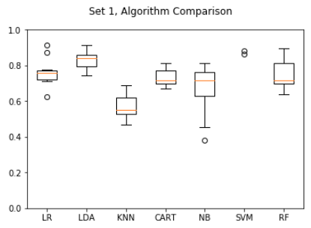
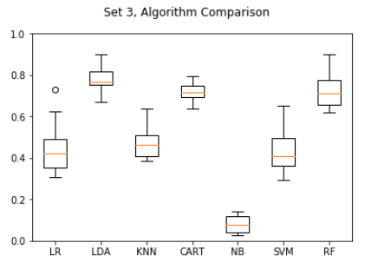
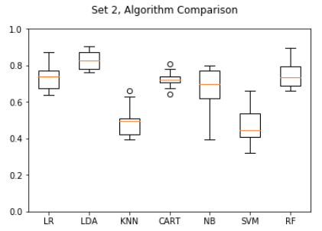
Baseline Accuracy Scores
Previous + Parts of Speech Metrics
Topics Only
Previous + Dummy Variables
High Performing Models:
Linear discriminant analysis (Red, 82.8,% 78%, 83%)
Random Forest (Blue 74%, 72%, 75%)

Slide 14

Going beyond baseline
Use Random Forest classifier because…
Many variables to data (> 300)
Many parameters to be tuned
LDA cannot be “Tuned” for performance
Does well with highly correlated variables
Easily get variable importance
“Forest” of models
=
100’s of Decision Tree models at random subsets of data

Slide 15
Results (1)
Best Accuracy: 84.6%
1.6 % improvement compared to LDA
+ 10% improvement compared to untuned Random Forest model
Details on best parameters:
Max Tree Depth = 50
Minimum Samples per Node = 50
Gini Impurity
Of 322 variables, randomly select 18 per tree
1000 Decision Trees
10 folds cross validation
10,000
Decision
Tree Models

Slide 16
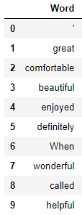
Results (2)
Topic 2 turned out to be most important. Here are some important words – most of them are positive adjectives and adverbs.
Variable | Importance Rank
Topic 2 | 1
Topic 6 | 2
Topic 3 | 3
Topic 4 | 4
Topic 12 | 5
Topic 15 | 6
Punctuation Count | 7

Slide 17
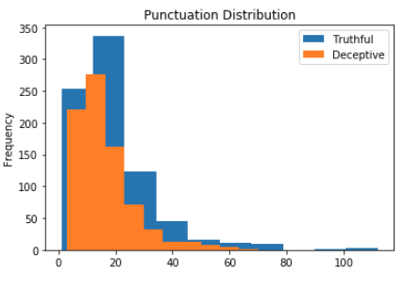
Results (3)
Descriptively, there is a noticeable difference in punctuation count between truthful and deceptive reviews.

Slide 18
Takeaways
We ended up with a model that achieved 84.6% accuracy with cross validation
We have identify a list of important “Topics” and variables.
Each topic can be “Opened up” to see what type of words show up.
The most important topic includes many key adjectives and adverbs
Punctuation frequency is also a good indicator

Slide 19
Takeaways and Next Steps
Productionizing:
Given this reasonable accuracy score, this model can be put into production to act as a “first line of defense” against fake reviews
Warnings:
Generalizability – it is important to continue to test this model for changes in effectiveness that warrant re-training.
Enrichment:
The model can be enriched by further experimenting with different preprocessing step

